Slide 1
Back-propagation neural network

Slide 2
Back-propagation neural network
Learning in a multilayer network proceeds the same way as for a perceptron.
A training set of input patterns is presented to the network.
The network computes its output pattern, and if there is an error − or in other words a difference between actual and desired output patterns − the weights are adjusted to reduce this error.

Slide 3
Back-propagation neural network
In a back-propagation neural network, the learning algorithm has two phases.
First, a training input pattern is presented to the network input layer. The network propagates the input pattern from layer to layer until the output pattern is generated by the output layer.
If this pattern is different from the desired output, an error is calculated and then propagated backwards through the network from the output layer to the input layer. The weights are modified as the error is propagated.

Slide 4
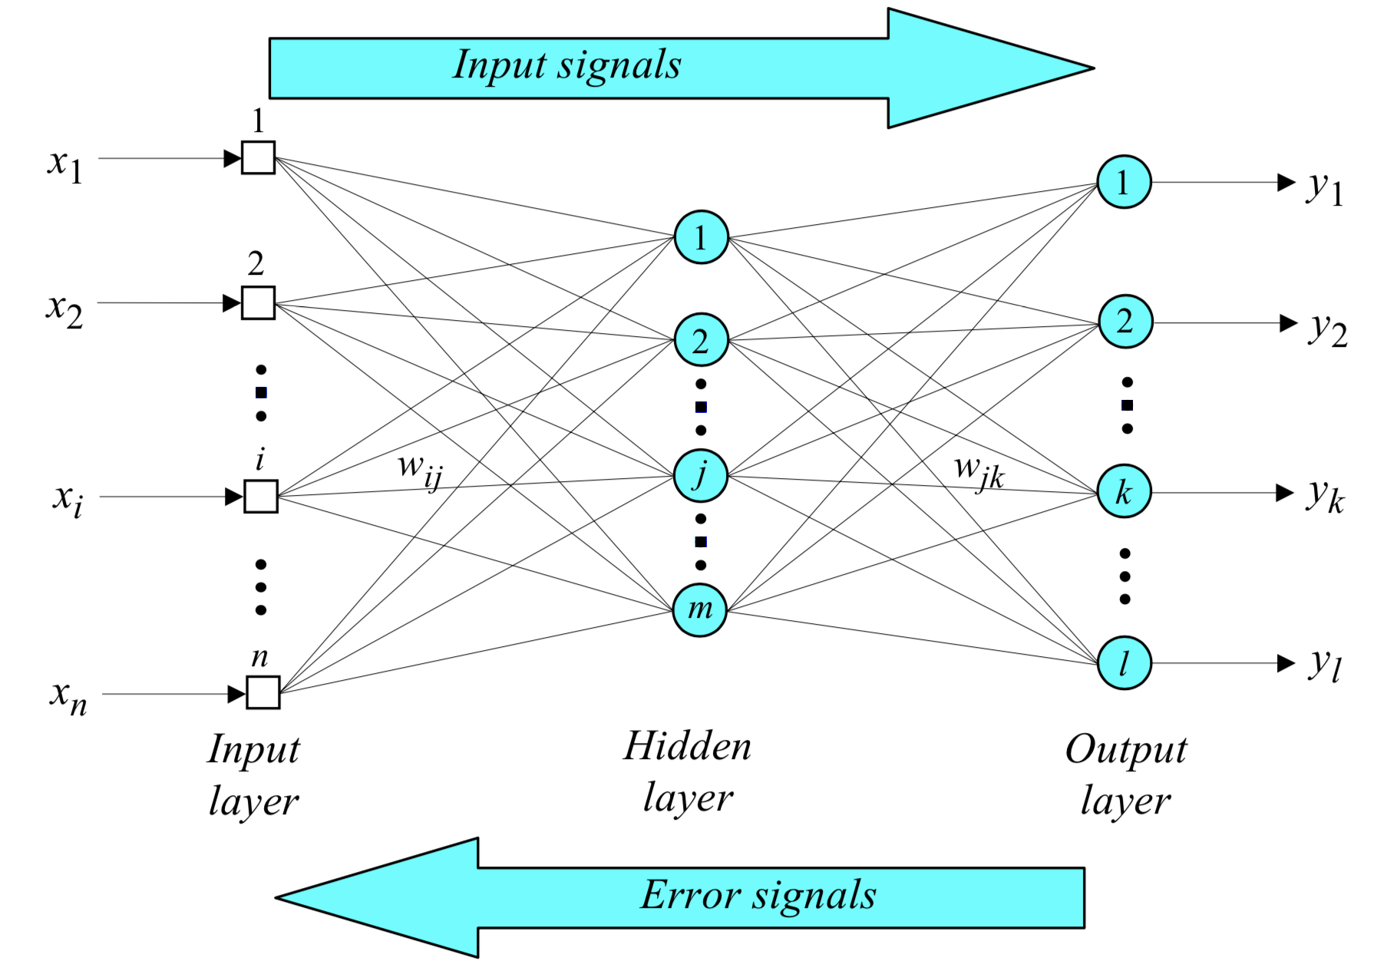
Three-layer back-propagation neural network

Slide 5
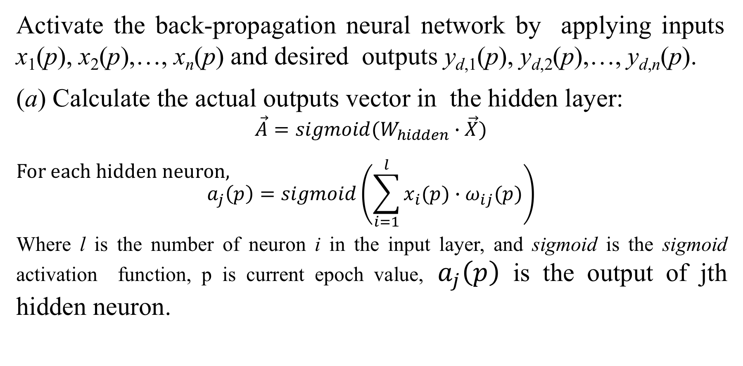
Step 1: Activation
Activate the back-propagation neural network by applying inputs x₁(p), x₂(p),…, x_{n}(p) and desired outputs y_{d,1}(p), y_{d,2}(p),…, y_{d,n}(p).
(a) Calculate the actual outputs vector in the hidden layer:
$$\vec{A}=sigmoid(W_{hidden}∙\vec{X})$$
For each hidden neuron,
$$a_{j}\left(p\right)=sigmoid\left(\sum_{i=1}^{l}{x_{i}(p)∙ω_{ij}(p)}\right)$$
Where l is the number of neuron i in the input layer, and sigmoid is the sigmoid activation function, p is current epoch value, $a_{j}\left(p\right)$ is the output of jth hidden neuron.

Slide 6
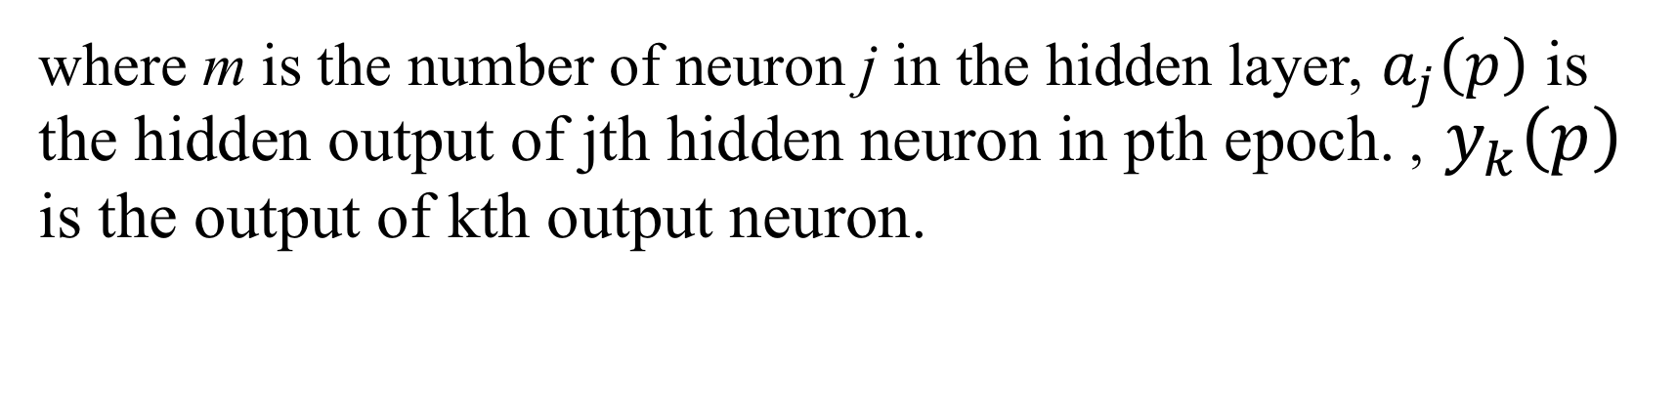
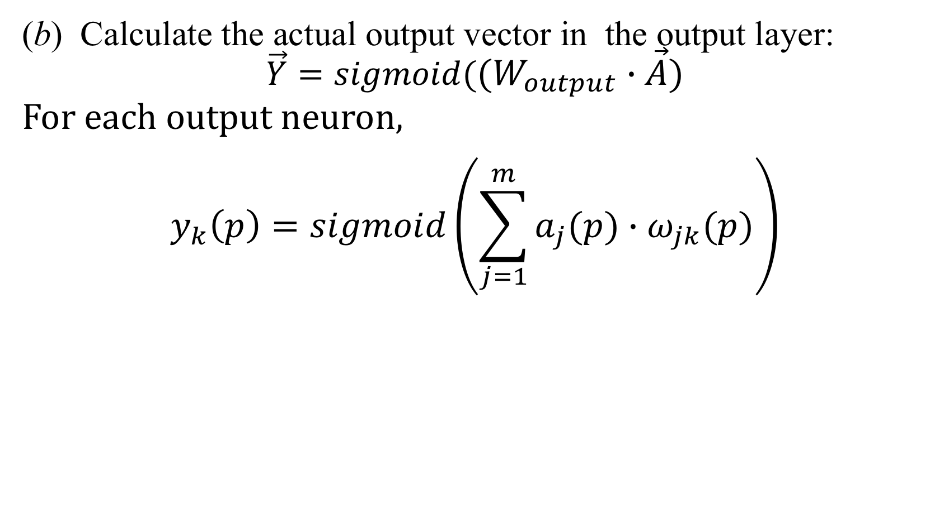
Step 1: Activation (continued)
(b) Calculate the actual output vector in the output layer:
$$\vec{Y}=sigmoid((W_{output}∙\vec{A})$$
For each output neuron,
$$y_{k}\left(p\right)=sigmoid\left(\sum_{j=1}^{m}{a_{j}(p)∙ω_{jk}(p)}\right)$$
where m is the number of neuron j in the hidden layer, $a_{j}\left(p\right)$ is the hidden output of jth hidden neuron in pth epoch. , $y_{k}\left(p\right)$ is the output of kth output neuron.

Slide 7

Step 1: Activation (continued)
$In assignment 04,\vec{A}(p)=\left[\begin{matrix}a_{1}\left(p\right) \\ a_{2}\left(p\right) \\ …… \\ a_{100}\left(p\right)\end{matrix}\right]$
$\vec{Y}(p)=\left[\begin{matrix}y_{1}\left(p\right) \\ y_{2}\left(p\right) \\ …… \\ y_{10}\left(p\right)\end{matrix}\right]$

Slide 8
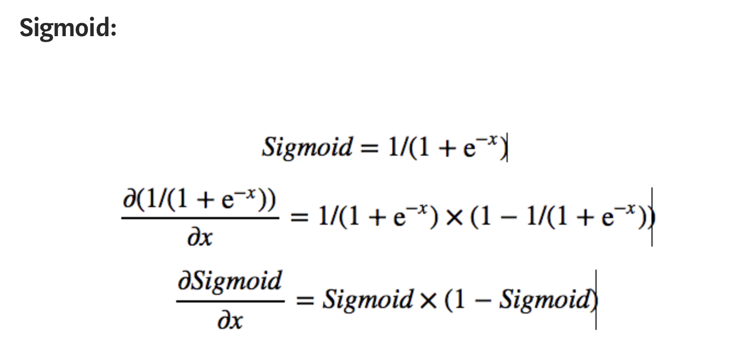
Important Derivatives:

Slide 9
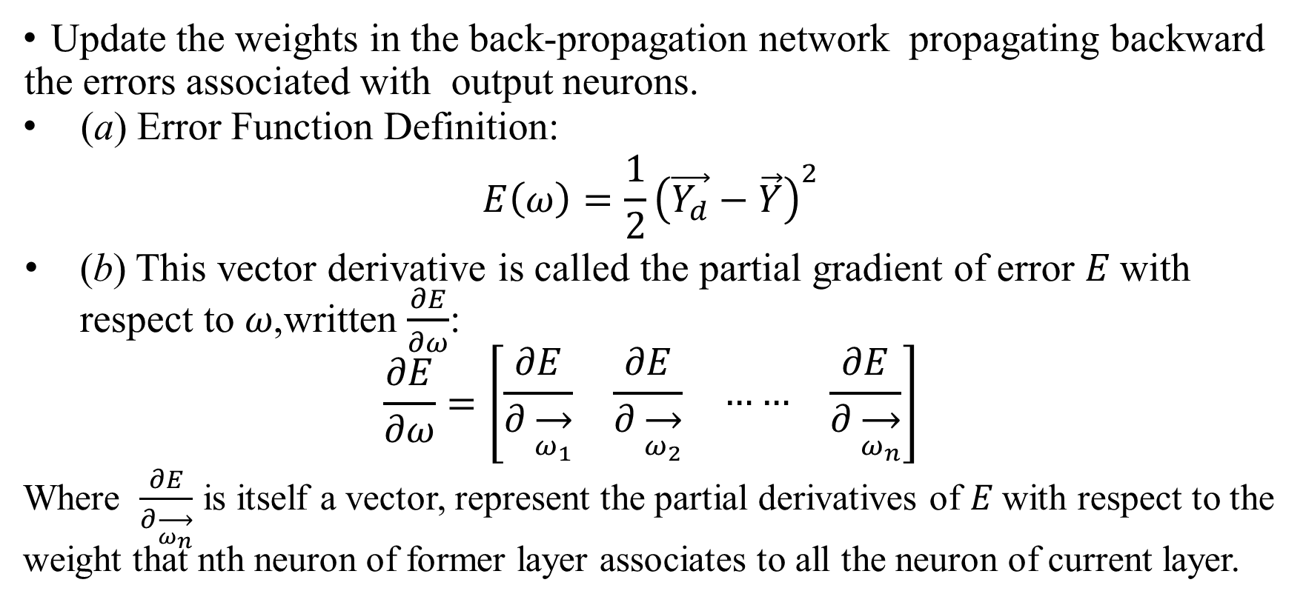
Step 2: Weight training
Update the weights in the back-propagation network propagating backward the errors associated with output neurons.
(a) Error Function Definition:
$$E\left(ω\right)=\frac{1}{2}{\left(\vec{Y_{d}}−\vec{Y}\right)}^{2}$$
(b) This vector derivative is called the partial gradient of error 𝐸 with respect to 𝜔,written $\frac{∂E}{∂ω}$:
$$\frac{∂E}{∂ω}=\left[\begin{matrix}\frac{∂E}{∂\overset{→}{ω_{1}}} & \frac{∂E}{∂\overset{→}{ω_{2}}} & …… & \frac{∂E}{∂\overset{→}{ω_{n}}}\end{matrix}\right]$$
Where $\frac{∂E}{∂\overset{→}{ω_{n}}}$ is itself a vector, represent the partial derivatives of 𝐸 with respect to the weight that nth neuron of former layer associates to all the neuron of current layer.

Slide 10
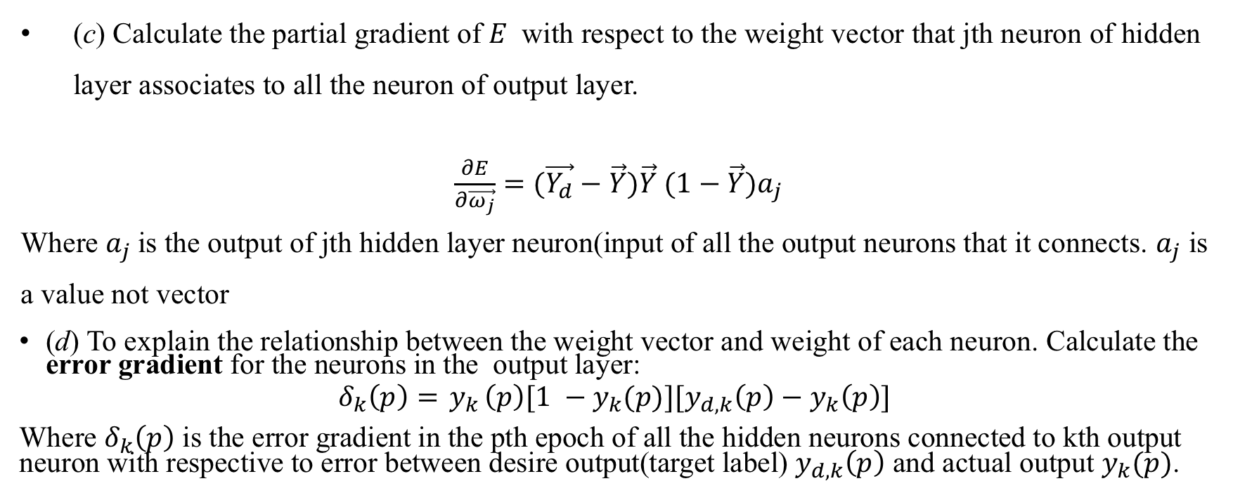
Step 2: Weight training - Output Layer
(c) Calculate the partial gradient of 𝐸 with respect to the weight vector that jth neuron of hidden layer associates to all the neuron of output layer.
$\frac{∂E}{∂\vec{ω_{j}}}=(\vec{Y_{d}}−\vec{Y})\vec{Y} (1−\vec{Y})a_{j}$
Where $a_{j}$is the output of jth hidden layer neuron(input of all the output neurons that it connects. $a_{j}$ is a value not vector
(d) To explain the relationship between the weight vector and weight of each neuron. Calculate the error gradient for the neurons in the output layer:
$$δ_{k}\left(p\right)={ y}_{k}\left(p\right)[1 −y_{k}(p)]{[y}_{d,k}\left(p\right)−y_{k}\left(p\right)]$$
Where $δ_{k}\left(p\right)$ is the error gradient in the pth epoch of all the hidden neurons connected to kth output neuron with respective to error between desire output(target label) $y_{d,k}\left(p\right)$ and actual output $y_{k}(p)$.

Slide 11
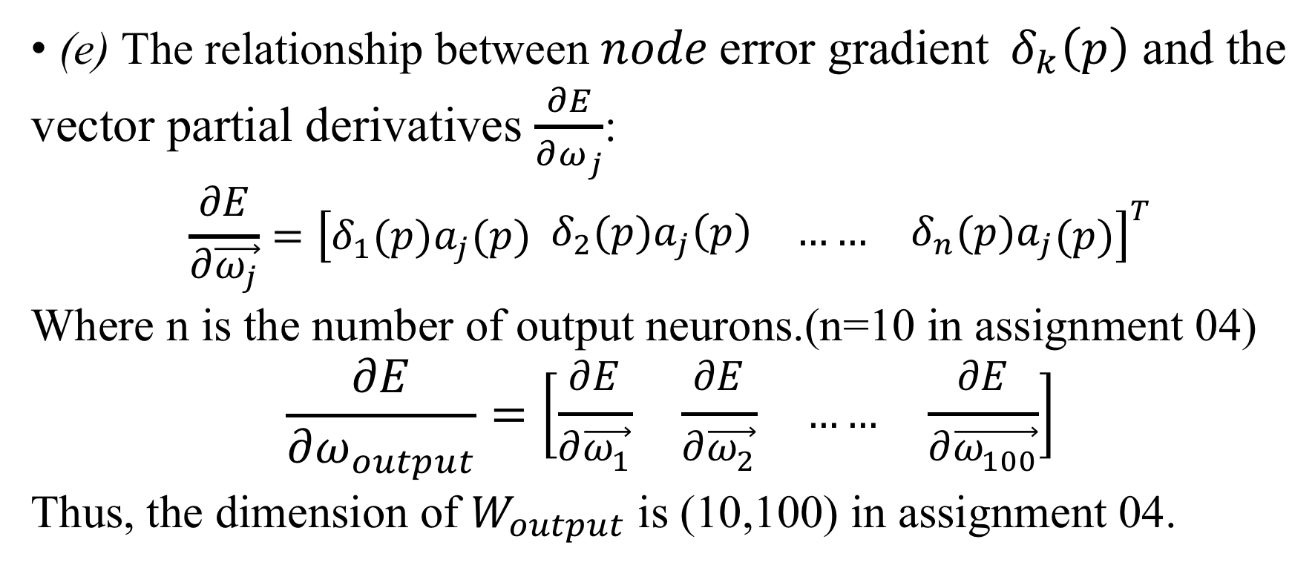
Step 2: Weight training - Output Layer
(e) The relationship between ${node \text{error} \text{gradient} δ}_{k}\left(p\right)$ and the
vector partial derivatives $\frac{∂E}{∂ω_{j}}$:
$$\frac{∂E}{∂\vec{ω_{j}}}={\left[δ_{1}(p)a_{j}(p) \begin{matrix}δ_{2}(p)a_{j}\left(p\right) & …… & δ_{n}(p)a_{j}\end{matrix}(p)\right]}^{T}$$
Where n is the number of output neurons.(n=10 in assignment 04)
$$\frac{∂E}{∂ω_{output}}=\left[\begin{matrix}\frac{∂E}{∂\vec{ω_{1}}} & \frac{∂E}{∂\vec{ω_{2}}} & …… & \frac{∂E}{∂\vec{ω_{100}}}\end{matrix}\right]$$
Thus, the dimension of $W_{output}$ is (10,100) in assignment 04.

Slide 12
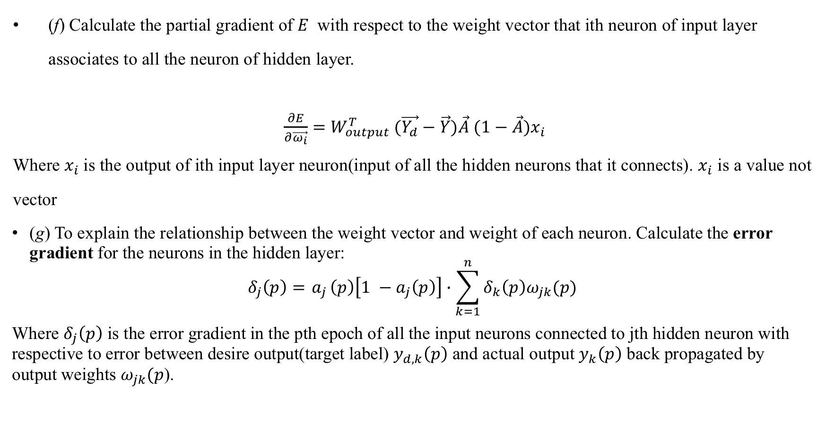
Step 2: Weight training - Hidden Layer
(f) Calculate the partial gradient of 𝐸 with respect to the weight vector that ith neuron of input layer associates to all the neuron of hidden layer.
$\frac{∂E}{∂\vec{ω_{i}}}=W_{output}^{T} (\vec{Y_{d}}−\vec{Y})\vec{A} (1−\vec{A})x_{i}$
Where $x_{i}$is the output of ith input layer neuron(input of all the hidden neurons that it connects). $x_{i}$ is a value not vector
(g) To explain the relationship between the weight vector and weight of each neuron. Calculate the error gradient for the neurons in the hidden layer:
$$δ_{j}\left(p\right)={ a}_{j}\left(p\right)\left[1 −a_{j}\left(p\right)\right]∙\sum_{k=1}^{n}{δ_{k}\left(p\right)ω_{jk}(p)}$$
Where $δ_{j}\left(p\right)$ is the error gradient in the pth epoch of all the input neurons connected to jth hidden neuron with respective to error between desire output(target label) $y_{d,k}\left(p\right)$ and actual output $y_{k}\left(p\right)$ back propagated by output weights $ω_{jk}(p$).

Slide 13
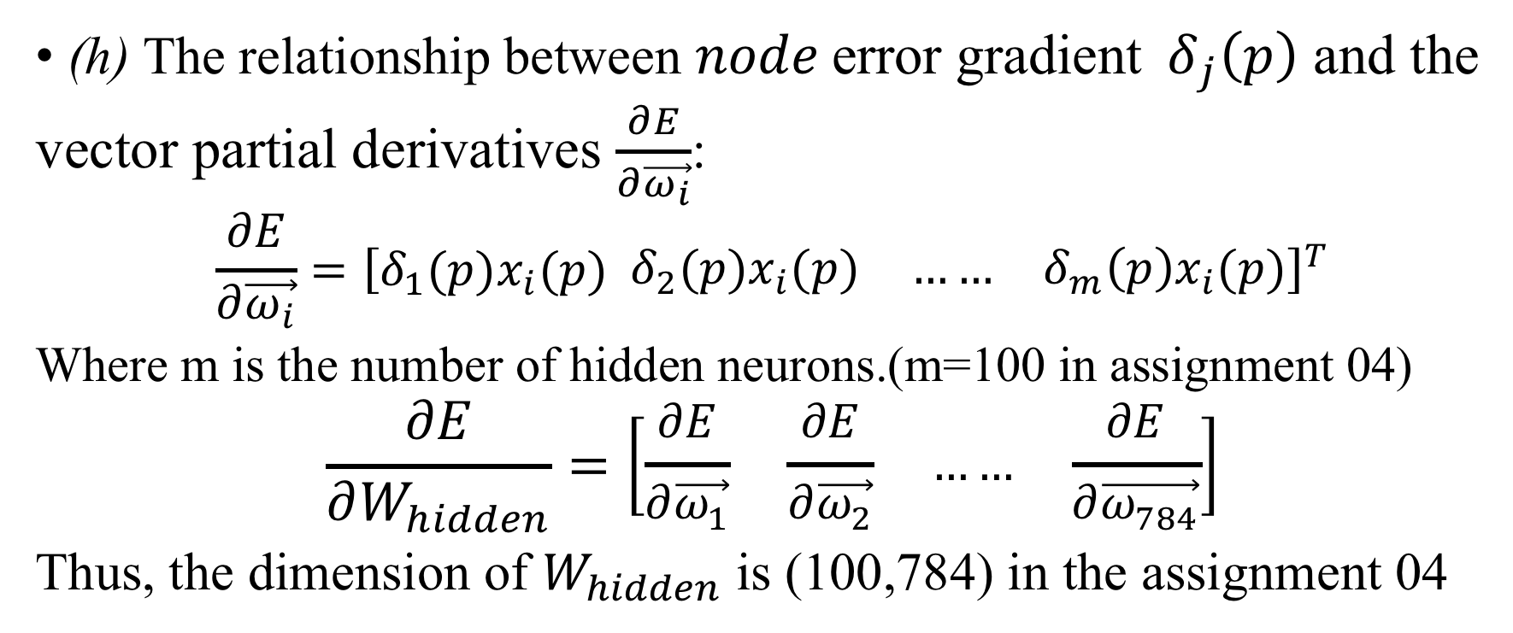
Step 2: Weight training - Hidden Layer
(h) The relationship between ${node \text{error} \text{gradient} δ}_{j}\left(p\right)$ and the
vector partial derivatives $\frac{∂E}{∂\vec{ω_{i}}}$:
$$\frac{∂E}{∂\vec{ω_{i}}}={\left[δ_{1}(p)x_{i}(p) \begin{matrix}δ_{2}(p)x_{i}(p) & …… & δ_{m}\left(p\right)x_{i}(p)\end{matrix}\right]}^{T}$$
Where m is the number of hidden neurons.(m=100 in assignment 04)
$$\frac{∂E}{∂W_{hidden}}=\left[\begin{matrix}\frac{∂E}{∂\vec{ω_{1}}} & \frac{∂E}{∂\vec{ω_{2}}} & …… & \frac{∂E}{∂\vec{ω_{784}}}\end{matrix}\right]$$
Thus, the dimension of $W_{hidden}$ is (100,784) in the assignment 04

Slide 14
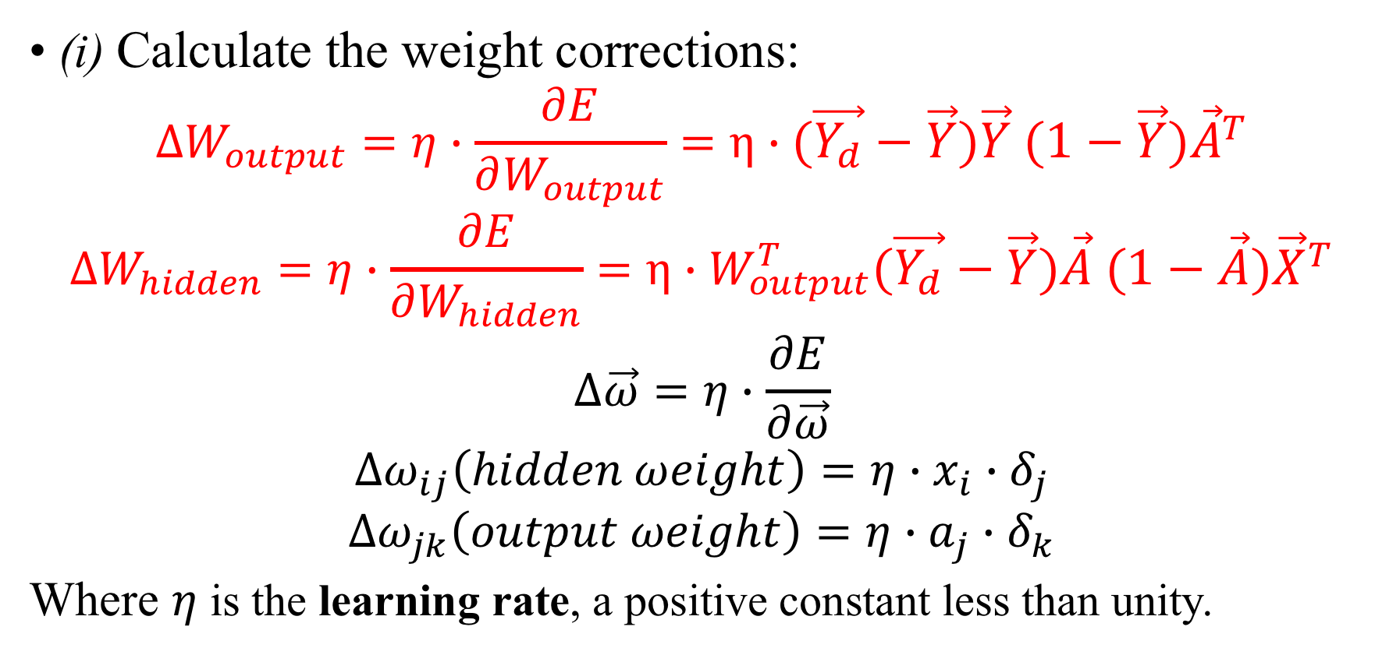
Step 2: Weight training (continued)
(i) Calculate the weight corrections:
$$∆W_{output}=η∙\frac{∂E}{∂W_{output}}=η∙(\vec{Y_{d}}−\vec{Y})\vec{Y} (1−\vec{Y}){\vec{A}}^{T}$$
$$∆W_{hidden}=η∙\frac{∂E}{∂W_{hidden}}=η∙W_{output}^{T}(\vec{Y_{d}}−\vec{Y})\vec{A} (1−\vec{A}){\vec{X}}^{T}$$
$$∆\vec{ω}=η∙\frac{∂E}{∂\vec{ω}}$$
$${Δω}_{ij}\left(hidden ωeight\right)=η∙x_{i}∙δ_{j}$$
$${Δω}_{jk}\left(output ωeight\right)=η∙a_{j}∙δ_{k}$$
Where $η$ is the learning rate, a positive constant less than unity.

Slide 15
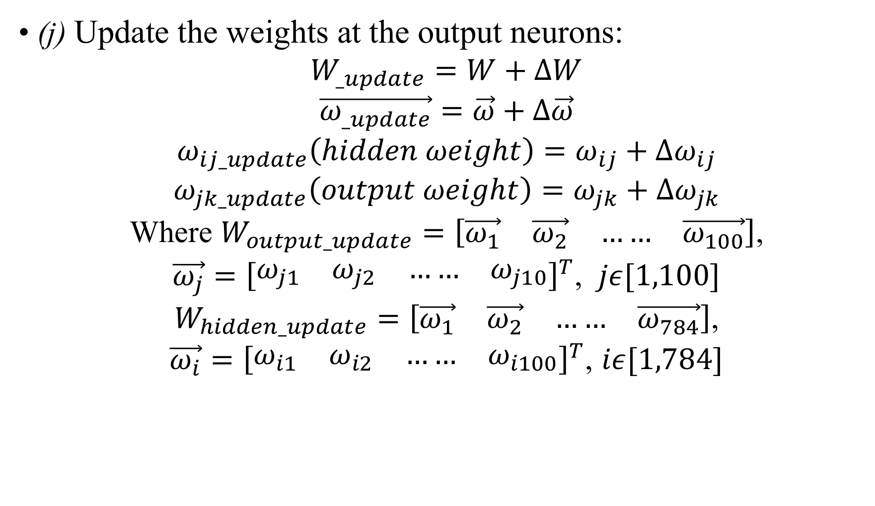
Step 2: Weight training (continued)
(j) Update the weights at the output neurons:
$$W_{_update}=W+∆W$$
$$\vec{ω_{_update}}=\vec{ω}+Δ\vec{ω}$$
$$ω_{ij_update}\left(hidden ωeight\right)=ω_{ij}+Δω_{ij}$$
$$ω_{jk_update}\left(output ωeight\right)=ω_{jk}+Δω_{jk}$$
Where $W_{output_update}=\left[\begin{matrix}\vec{ω_{1}} & \vec{ω_{2}} & …… & \vec{ω_{100}}\end{matrix}\right]$,
$\vec{ω_{j}}={\left[\begin{matrix}ω_{j1} & ω_{j2} & …… & ω_{j10}\end{matrix}\right]}^{T}$, $jε[1,100]$
$W_{hidden_update}=\left[\begin{matrix}\vec{ω_{1}} & \vec{ω_{2}} & …… & \vec{ω_{784}}\end{matrix}\right]$,
$\vec{ω_{i}}={\left[\begin{matrix}ω_{i1} & ω_{i2} & …… & ω_{i100}\end{matrix}\right]}^{T}$, $iε[1,784]$

Slide 16
Step 3: Iteration
Increase iteration p by one, go back to Step 1 and repeat the process until the selected error criterion is satisfied.

Slide 17
Architecture:
Now we will apply the three-layer net to illustrate the peceptron and backpropagation.
Build a Feed Forward neural network with 1 hidden layers. All the layers have 3 Neurons each.
Hidden layer will have sigmoid as activation functions.
Error is calculated using gradient ascent.

Slide 18


Initializing the network
Input(i)
$$ω_{ij}$$
Hidden layer(j)
$$ω_{jk}$$
Output(k)
x₁
y₇
1
w₁₄
4
a₄
w₄₇
7
w₂₄
w₅₇
w₆₇
w₃₄
w₁₅
w₄₈
x₂
w₂₅
a₅
y₈
2
5
w₅₈
8
w₃₅
w₆₈
w₁₆
w₄₉
w₂₆
w₅₉
x₃
a₆
y₉
3
w₃₆
6
w₆₉
9
Sigmoid

Slide 19
Neural Network Layer
Input
Hidden
Output
x₁
h₁
a₄
y₇
x₂
h₂
a₅
y₈
x₃
h₃
a₆
y₉
Sigmoid

Slide 20
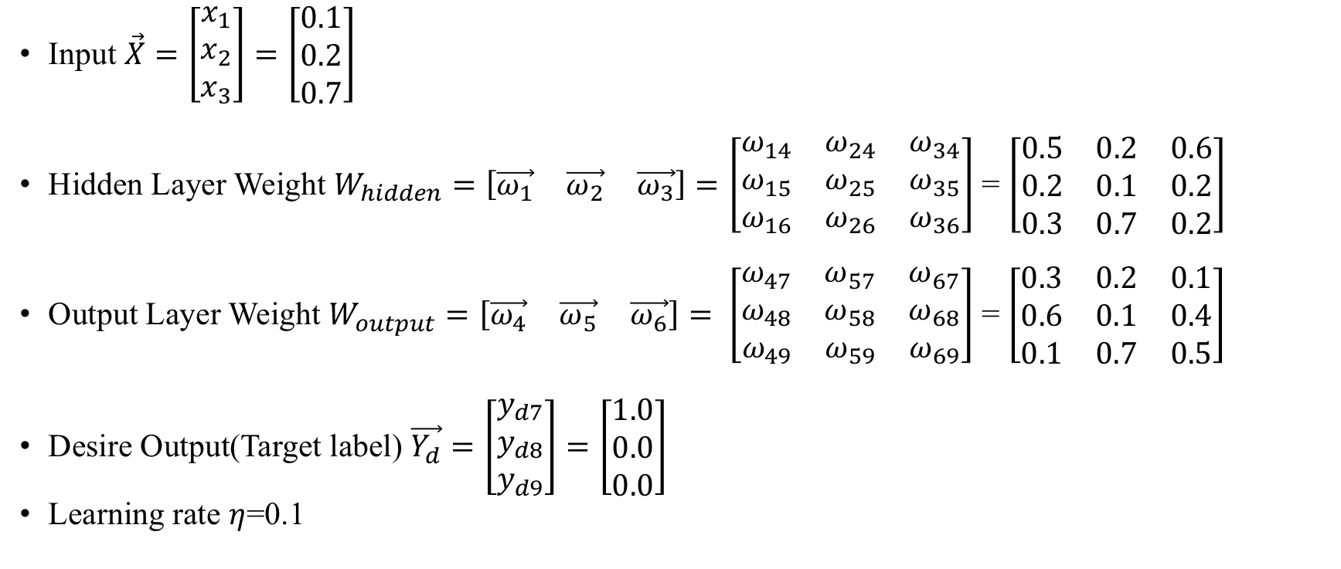
Initializing the network
Input $\vec{X}=\left[\begin{matrix}x_{1} \\ x_{2} \\ x_{3}\end{matrix}\right]=\left[\begin{matrix}0.1 \\ 0.2 \\ 0.7\end{matrix}\right]$
Hidden Layer Weight $W_{hidden}=\left[\begin{matrix}\vec{ω_{1}} & \vec{ω_{2}} & \vec{ω_{3}}\end{matrix}\right]=\left[\begin{matrix}ω_{14} & ω_{24} & ω_{34} \\ ω_{15} & ω_{25} & ω_{35} \\ ω_{16} & ω_{26} & ω_{36}\end{matrix}\right]$ = $\left[\begin{matrix}0.5 & 0.2 & 0.6 \\ 0.2 & 0.1 & 0.2 \\ 0.3 & 0.7 & 0.2\end{matrix}\right]$
Output Layer Weight $W_{output}=\left[\begin{matrix}\vec{ω_{4}} & \vec{ω_{5}} & \vec{ω_{6}}\end{matrix}\right]= \left[\begin{matrix}ω_{47} & ω_{57} & ω_{67} \\ ω_{48} & ω_{58} & ω_{68} \\ ω_{49} & ω_{59} & ω_{69}\end{matrix}\right]$ = $\left[\begin{matrix}0.3 & 0.2 & 0.1 \\ 0.6 & 0.1 & 0.4 \\ 0.1 & 0.7 & 0.5\end{matrix}\right]$
Desire Output(Target label) $\vec{Y_{d}}=\left[\begin{matrix}y_{d7} \\ y_{d8} \\ y_{d9}\end{matrix}\right]=\left[\begin{matrix}1.0 \\ 0.0 \\ 0.0\end{matrix}\right]$
Learning rate $η$=0.1

Slide 21
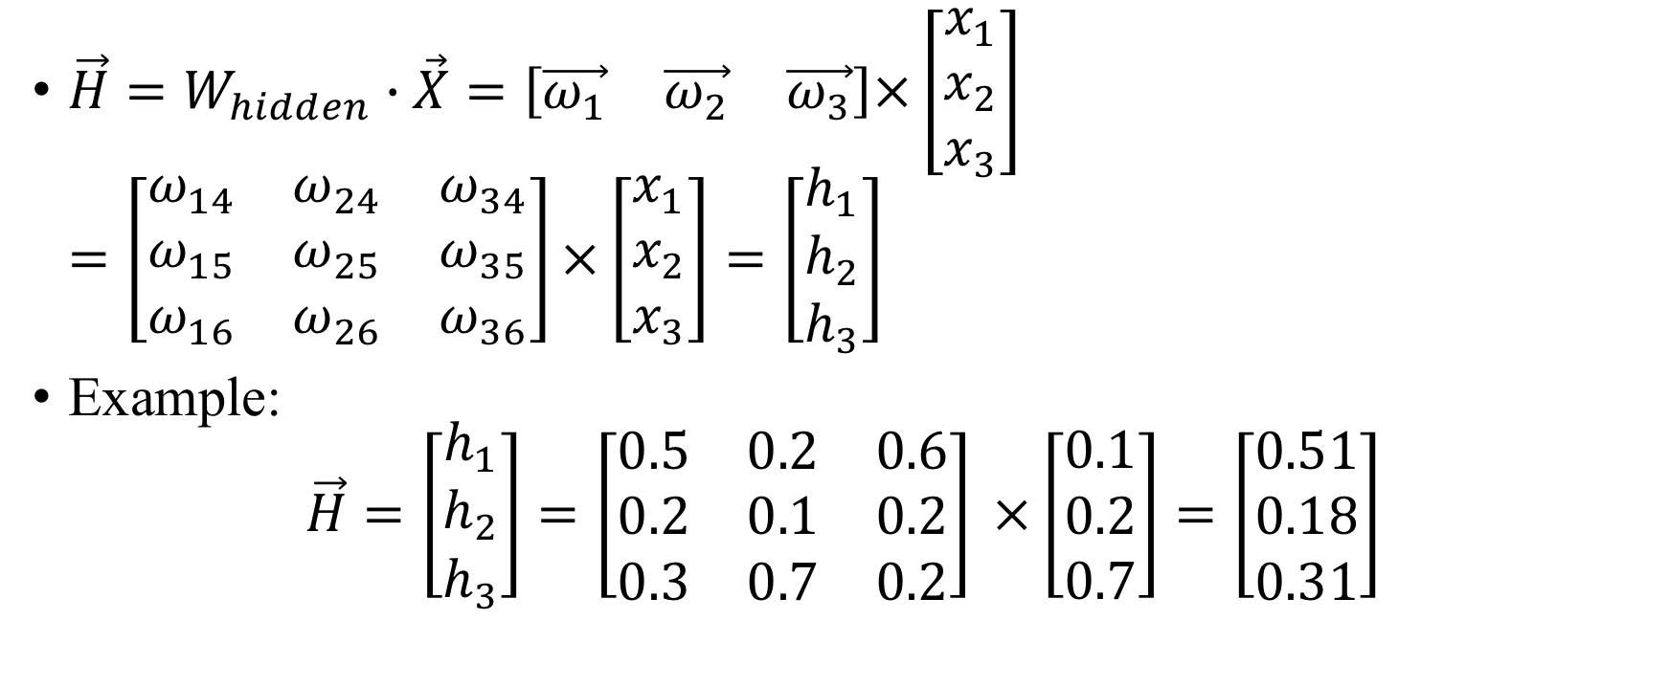
Input Layer Matrix Operation
${\vec{H}=W}_{hidden}∙\vec{X}=\left[\begin{matrix}\vec{ω_{1}} & \vec{ω_{2}} & \vec{ω_{3}}\end{matrix}\right]\text{×}\left[\begin{matrix}x_{1} \\ x_{2} \\ x_{3}\end{matrix}\right]=\left[\begin{matrix}ω_{14} & ω_{24} & ω_{34} \\ ω_{15} & ω_{25} & ω_{35} \\ ω_{16} & ω_{26} & ω_{36}\end{matrix}\right]\text{×}\left[\begin{matrix}x_{1} \\ x_{2} \\ x_{3}\end{matrix}\right]=\left[\begin{matrix}h_{1} \\ h_{2} \\ h_{3}\end{matrix}\right]$
Example:
$$\vec{H}=\left[\begin{matrix}h_{1} \\ h_{2} \\ h_{3}\end{matrix}\right]=\left[\begin{matrix}0.5 & 0.2 & 0.6 \\ 0.2 & 0.1 & 0.2 \\ 0.3 & 0.7 & 0.2\end{matrix}\right] \text{×}\left[\begin{matrix}0.1 \\ 0.2 \\ 0.7\end{matrix}\right]=\left[\begin{matrix}0.51 \\ 0.18 \\ 0.31\end{matrix}\right]$$

Slide 22

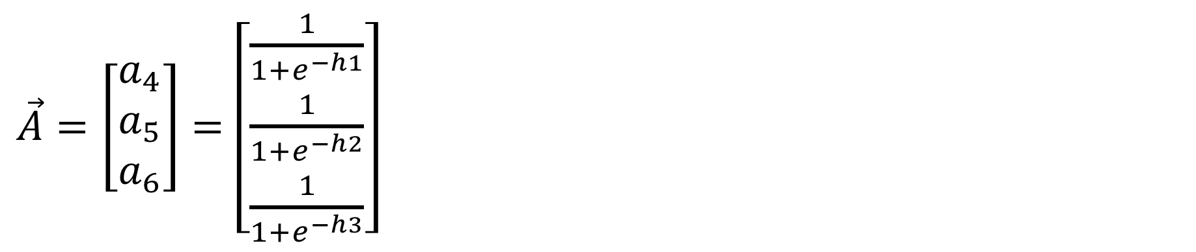
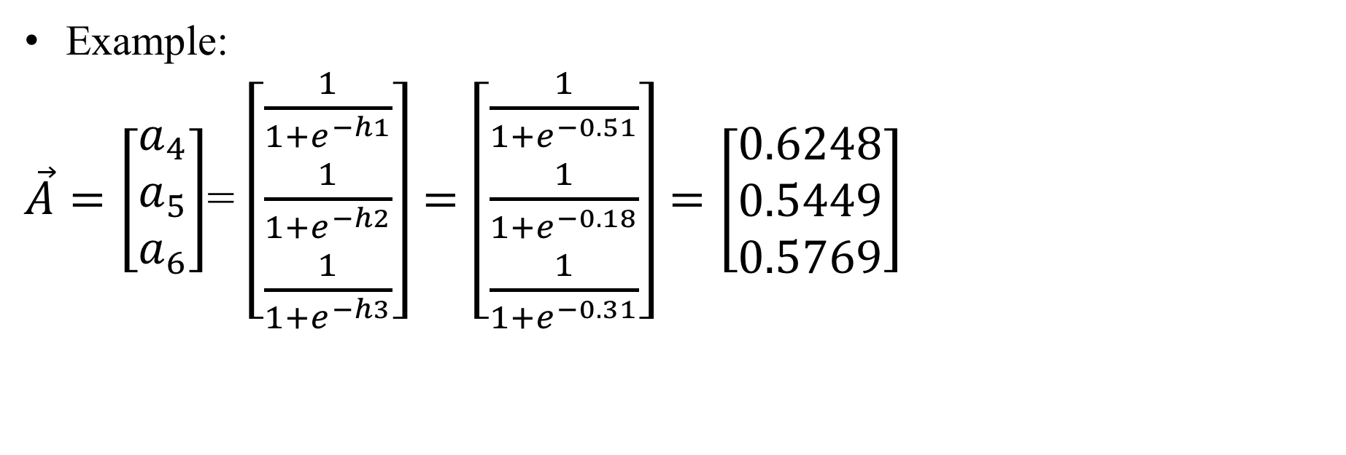
Sigmoid Operation-Hidden Layer
$\vec{A}=\left[\begin{matrix}a_{4} \\ a_{5} \\ a_{6}\end{matrix}\right]=$ $\left[\begin{matrix}\frac{1}{1+e^{−h1}} \\ \frac{1}{1+e^{−h2}} \\ \frac{1}{1+e^{−h3}}\end{matrix}\right]$
Example:
$\vec{A}=\left[\begin{matrix}a_{4} \\ a_{5} \\ a_{6}\end{matrix}\right]$= $\left[\begin{matrix}\frac{1}{1+e^{−h1}} \\ \frac{1}{1+e^{−h2}} \\ \frac{1}{1+e^{−h3}}\end{matrix}\right]=\left[\begin{matrix}\frac{1}{1+e^{−0.51}} \\ \frac{1}{1+e^{−0.18}} \\ \frac{1}{1+e^{−0.31}}\end{matrix}\right]=\left[\begin{matrix}0.6248 \\ 0.5449 \\ 0.5769\end{matrix}\right]$

Slide 23

Sigmoid Operation-Output Layer
$\vec{Y}=\left[\begin{matrix}y_{7} \\ y_{8} \\ y_{9}\end{matrix}\right]$= Sigmoid($W_{output}∙\vec{A}$)
=Sigmoid($\left[\begin{matrix}ω_{47} & ω_{57} & ω_{67} \\ ω_{48} & ω_{58} & ω_{68} \\ ω_{49} & ω_{59} & ω_{69}\end{matrix}\right] \text{×}\left[\begin{matrix}a_{4} \\ a_{5} \\ a_{6}\end{matrix}\right]$)
= Sigmoid($\left[\begin{matrix}0.3 & 0.2 & 0.1 \\ 0.6 & 0.1 & 0.4 \\ 0.1 & 0.7 & 0.5\end{matrix}\right] ×\left[\begin{matrix}0.6248 \\ 0.5449 \\ 0.5769\end{matrix}\right]\text{)}$
= Sigmoid($\left[\begin{matrix}0.3541 \\ 0.6601 \\ 0.7324\end{matrix}\right]$)
= $\left[\begin{matrix}0.5876 \\ 0.6593 \\ 0.6753\end{matrix}\right]$

Slide 24
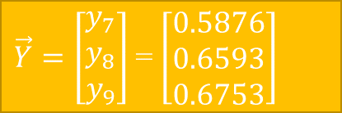


Error gradient Calculation-Output Layer
$\left[\begin{matrix}{\text{}}_{7} \\ {\text{}}_{8} \\ {\text{}}_{9}\end{matrix}\right]=\left(\vec{Y_{d}}−\vec{Y}\right)∗\vec{Y} ∗\left(1−\vec{Y}\right)=\left[\begin{matrix}y_{7}(1−y_{7})(y_{d7}−y_{7}) \\ y_{8}(1−y_{8})(y_{d8}−y_{8}) \\ y_{9}(1−y_{9})(y_{d9}−y_{9})\end{matrix}\right]=\left[\begin{matrix}0.0999 \\ −0.1481 \\ −0.1481\end{matrix}\right]$
$\vec{Y}=\left[\begin{matrix}y_{7} \\ y_{8} \\ y_{9}\end{matrix}\right]$= $\left[\begin{matrix}0.5876 \\ 0.6593 \\ 0.6753\end{matrix}\right]$
$$\vec{Y_{d}}=\left[\begin{matrix}y_{d7} \\ y_{d8} \\ y_{d9}\end{matrix}\right]=\left[\begin{matrix}1.0 \\ 0.0 \\ 0.0\end{matrix}\right]$$

Slide 25

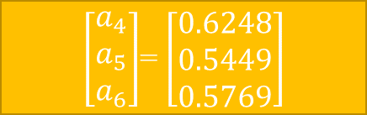

Partial gradient of E with respect to W-Output Layer
$$\left[\begin{matrix}{\text{}}_{7} \\ {\text{}}_{8} \\ {\text{}}_{9}\end{matrix}\right]=\left[\begin{matrix}0.0999 \\ −0.1481 \\ −0.1481\end{matrix}\right]$$
$\frac{∂E}{∂W_{output}}=\left[\begin{matrix}\frac{∂E}{∂\vec{ω_{4}}} & \frac{∂E}{∂\vec{ω_{5}}} & \frac{∂E}{∂\vec{ω_{6}}}\end{matrix}\right]=\left[\begin{matrix}a_{4}δ_{7} & a_{5}δ_{7} & a_{6}δ_{7} \\ a_{4}δ_{8} & a_{5}δ_{8} & a_{6}δ_{8} \\ a_{4}δ_{9} & a_{5}δ_{9} & a_{6}δ_{9}\end{matrix}\right]$
$=\left[\begin{matrix}0.0624 & 0.0544 & 0.0576 \\ −0.0925 & −0.0807 & −0.0854 \\ −0.0925 & −0.0807 & −0.0854\end{matrix}\right]$
$\left[\begin{matrix}a_{4} \\ a_{5} \\ a_{6}\end{matrix}\right]$= $\left[\begin{matrix}0.6248 \\ 0.5449 \\ 0.5769\end{matrix}\right]$

Slide 26
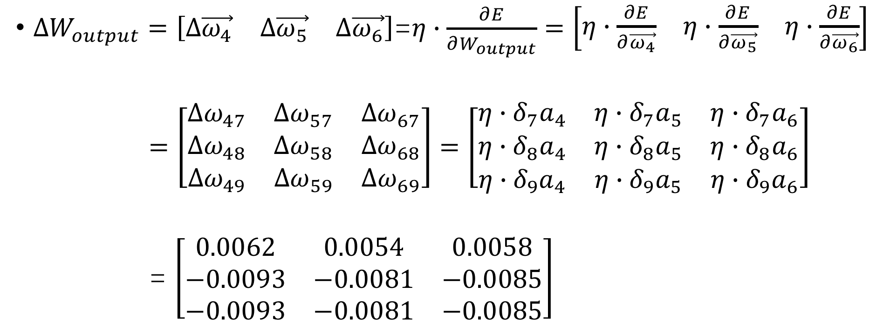
Weight corrections Calculation-Output Layer
$∆W_{output}=\left[\begin{matrix}Δ\vec{ω_{4}} & Δ\vec{ω_{5}} & Δ\vec{ω_{6}}\end{matrix}\right]\text{=}η∙\frac{∂E}{∂W_{output}}=\left[\begin{matrix}η∙\frac{∂E}{∂\vec{ω_{4}}} & η∙\frac{∂E}{∂\vec{ω_{5}}} & η∙\frac{∂E}{∂\vec{ω_{6}}}\end{matrix}\right]$
$=\left[\begin{matrix}{Δω}_{47} & {Δω}_{57} & Δω_{67} \\ {Δω}_{48} & {Δω}_{58} & {Δω}_{68} \\ {Δω}_{49} & Δω_{59} & Δω_{69}\end{matrix}\right]=\left[\begin{matrix}η∙δ_{7}a_{4} & η∙δ_{7}a_{5} & η∙δ_{7}a_{6} \\ η∙δ_{8}a_{4} & η∙δ_{8}a_{5} & η∙δ_{8}a_{6} \\ {η∙δ}_{9}a_{4} & {η∙δ}_{9}a_{5} & η∙δ_{9}a_{6}\end{matrix}\right]$
= $\left[\begin{matrix}0.0062 & 0.0054 & 0.0058 \\ −0.0093 & −0.0081 & −0.0085 \\ −0.0093 & −0.0081 & −0.0085\end{matrix}\right]$

Slide 27

Error gradient Calculation-Hidden Layer
$\left[\begin{matrix}{\text{}}_{4} \\ {\text{}}_{5} \\ {\text{}}_{6}\end{matrix}\right]=\left[\begin{matrix}a_{4}\left(1−a_{4}\right)({\text{}}_{7}ω_{47}+{\text{}}_{8}ω_{48}+{\text{}}_{9}ω_{49}) \\ a_{5}\left(1−a_{5}\right)({\text{}}_{7}ω_{47}+{\text{}}_{8}ω_{48}+{\text{}}_{9}ω_{49}) \\ a_{6}\left(1−a_{6}\right)({\text{}}_{7}ω_{47}+{\text{}}_{8}ω_{48}+{\text{}}_{9}ω_{49})\end{matrix}\right]$
Detailed calculation is similar to output layer.

Slide 28

Partial gradient of E with respect to W-Hidden Layer
$\frac{∂E}{∂W_{hidden}}=\left[\begin{matrix}\frac{∂E}{∂\vec{ω_{1}}} & \frac{∂E}{∂\vec{ω_{2}}} & \frac{∂E}{∂\vec{ω_{3}}}\end{matrix}\right]=\left[\begin{matrix}δ_{4}x_{1} & δ_{4}x_{2} & δ_{4}x_{3} \\ δ_{5}x_{1} & δ_{5}x_{2} & δ_{5}x_{3} \\ δ_{6}x_{1} & δ_{6}x_{2} & δ_{6}x_{3}\end{matrix}\right]$
Detailed calculation is similar to output layer.

Slide 29
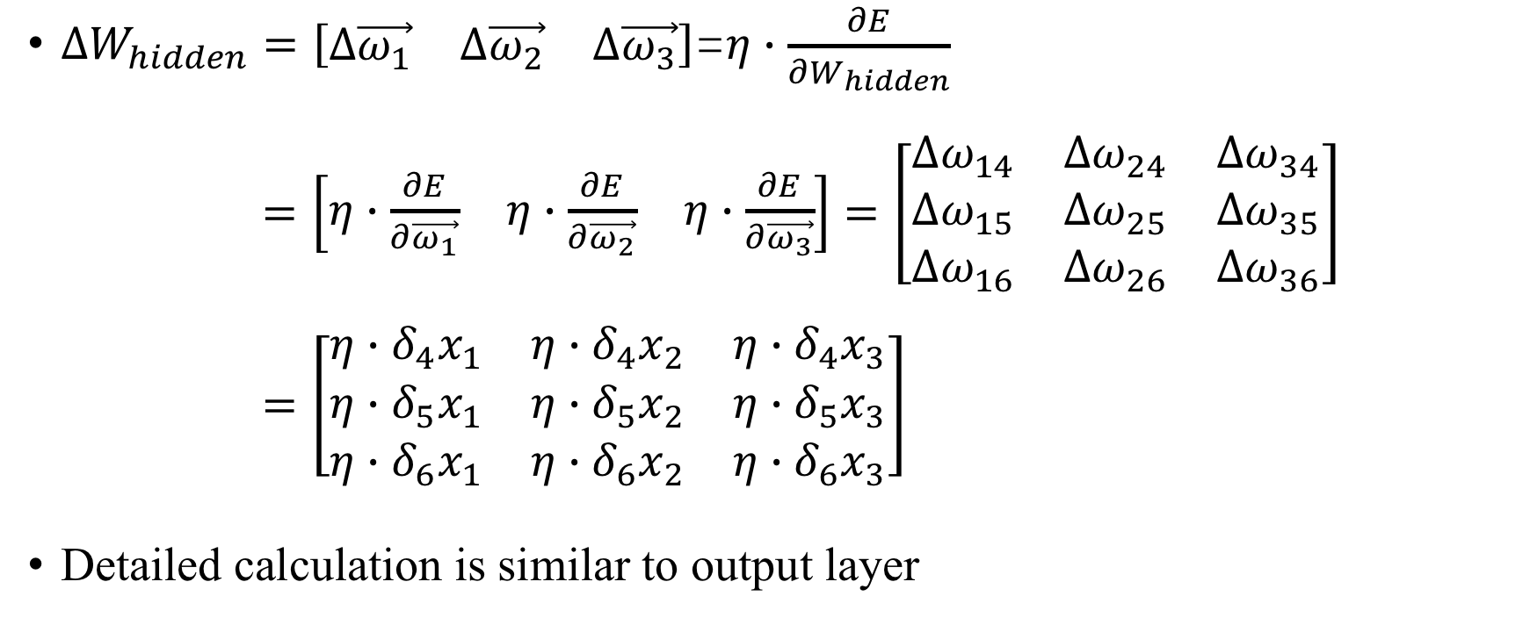
Weight corrections Calculation-Hidden Layer
$∆W_{hidden}=\left[\begin{matrix}Δ\vec{ω_{1}} & Δ\vec{ω_{2}} & Δ\vec{ω_{3}}\end{matrix}\right]\text{=}η∙\frac{∂E}{∂W_{hidden}}$
$=\left[\begin{matrix}η∙\frac{∂E}{∂\vec{ω_{1}}} & η∙\frac{∂E}{∂\vec{ω_{2}}} & η∙\frac{∂E}{∂\vec{ω_{3}}}\end{matrix}\right]=\left[\begin{matrix}{Δω}_{14} & {Δω}_{24} & Δω_{34} \\ {Δω}_{15} & {Δω}_{25} & {Δω}_{35} \\ {Δω}_{16} & Δω_{26} & Δω_{36}\end{matrix}\right]$
$=\left[\begin{matrix}{η∙δ}_{4}x_{1} & {η∙δ}_{4}x_{2} & {η∙δ}_{4}x_{3} \\ {η∙δ}_{5}x_{1} & η∙δ_{5}x_{2} & η∙δ_{5}x_{3} \\ {η∙δ}_{6}x_{1} & η∙δ_{6}x_{2} & η∙δ_{6}x_{3}\end{matrix}\right]$
Detailed calculation is similar to output layer

Slide 30
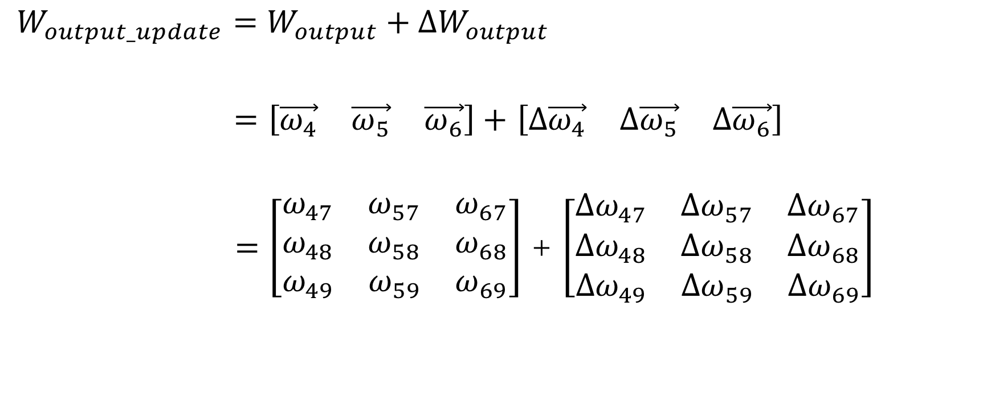
Update the weights- Output layer
$W_{output_update}=W_{output}+ΔW_{output}$
$=\left[\begin{matrix}\vec{ω_{4}} & \vec{ω_{5}} & \vec{ω_{6}}\end{matrix}\right]+$ $\left[∆\begin{matrix}\vec{ω_{4}} & ∆\vec{ω_{5}} & ∆\vec{ω_{6}}\end{matrix}\right]$
$=$ $\left[\begin{matrix}ω_{47} & ω_{57} & ω_{67} \\ ω_{48} & ω_{58} & ω_{68} \\ ω_{49} & ω_{59} & ω_{69}\end{matrix}\right]$ + $\left[\begin{matrix}{Δω}_{47} & {Δω}_{57} & Δω_{67} \\ {Δω}_{48} & {Δω}_{58} & {Δω}_{68} \\ {Δω}_{49} & Δω_{59} & Δω_{69}\end{matrix}\right]$

Slide 31
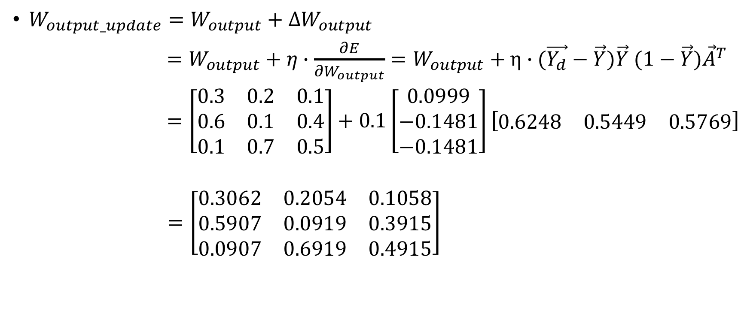
Update the weights- Output layer
$W_{output_update}=W_{output}+ΔW_{output}$
$=W_{output}+η∙\frac{∂E}{∂W_{output}}=W_{output}+η∙(\vec{Y_{d}}−\vec{Y})\vec{Y} (1−\vec{Y}){\vec{A}}^{T}$
$=\left[\begin{matrix}0.3 & 0.2 & 0.1 \\ 0.6 & 0.1 & 0.4 \\ 0.1 & 0.7 & 0.5\end{matrix}\right]+0.1\left[\begin{matrix}0.0999 \\ −0.1481 \\ −0.1481\end{matrix}\right]\left[\begin{matrix}0.6248 & 0.5449 & 0.5769\end{matrix}\right]$
$=\left[\begin{matrix}0.3062 & 0.2054 & 0.1058 \\ 0.5907 & 0.0919 & 0.3915 \\ 0.0907 & 0.6919 & 0.4915\end{matrix}\right]$

Slide 32
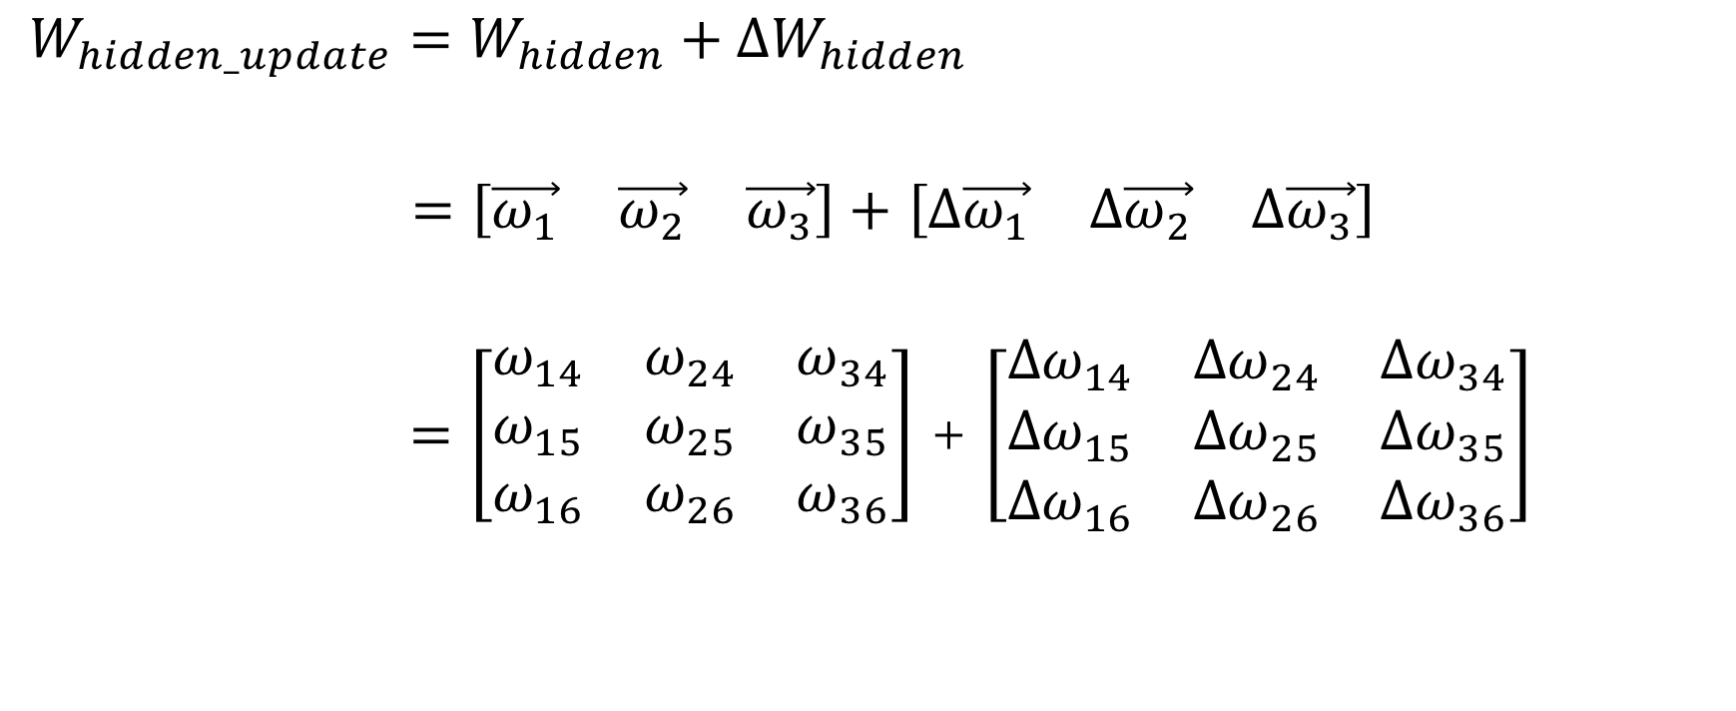
Update the weights- Hidden layer
$W_{hidden_update}=W_{hidden}+ΔW_{hidden}$
$=\left[\begin{matrix}\vec{ω_{1}} & \vec{ω_{2}} & \vec{ω_{3}}\end{matrix}\right]+$ $\left[∆\begin{matrix}\vec{ω_{1}} & ∆\vec{ω_{2}} & ∆\vec{ω_{3}}\end{matrix}\right]$
$=\left[\begin{matrix}ω_{14} & ω_{24} & ω_{34} \\ ω_{15} & ω_{25} & ω_{35} \\ ω_{16} & ω_{26} & ω_{36}\end{matrix}\right]$ + $\left[\begin{matrix}{Δω}_{14} & {Δω}_{24} & Δω_{34} \\ {Δω}_{15} & {Δω}_{25} & {Δω}_{35} \\ {Δω}_{16} & Δω_{26} & Δω_{36}\end{matrix}\right]$

Slide 33
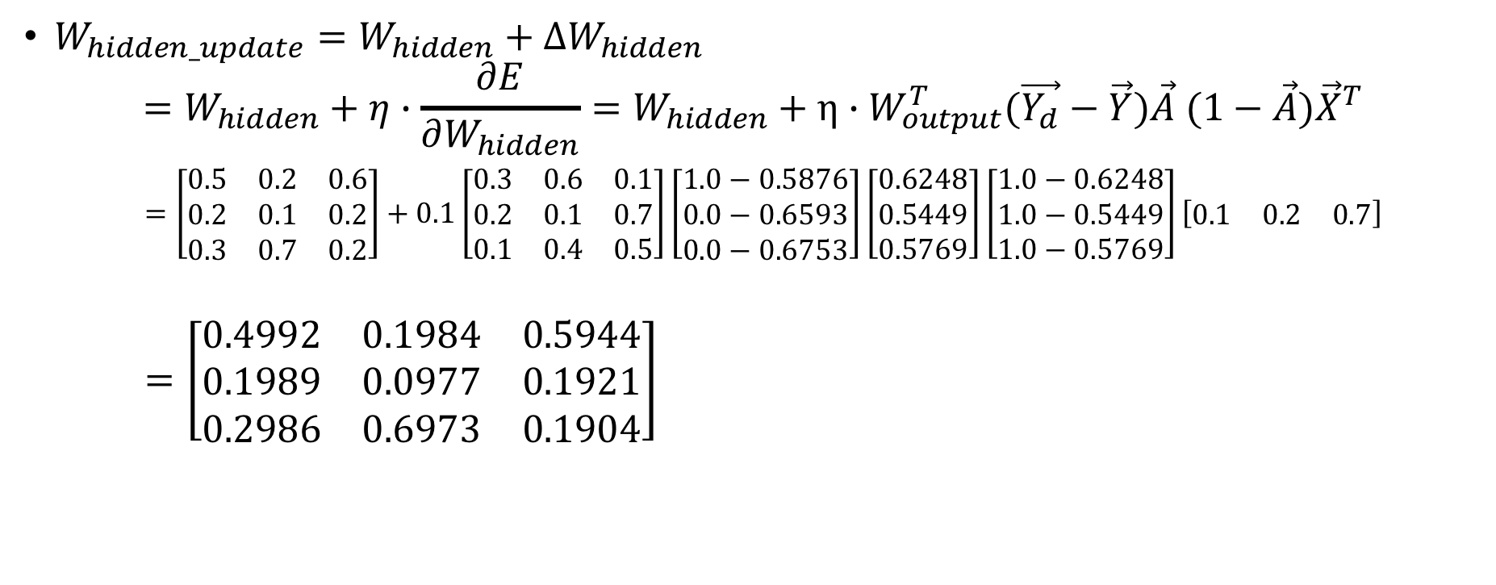
Update the weights- Hidden layer
$W_{hidden_update}=W_{hidden}+ΔW_{hidden}$
$$=W_{hidden}+η∙\frac{∂E}{∂W_{hidden}}=W_{hidden}+η∙W_{output}^{T}(\vec{Y_{d}}−\vec{Y})\vec{A} (1−\vec{A}){\vec{X}}^{T}$$
$=\left[\begin{matrix}0.5 & 0.2 & 0.6 \\ 0.2 & 0.1 & 0.2 \\ 0.3 & 0.7 & 0.2\end{matrix}\right]+0.1\left[\begin{matrix}0.3 & 0.6 & 0.1 \\ 0.2 & 0.1 & 0.7 \\ 0.1 & 0.4 & 0.5\end{matrix}\right]\left[\begin{matrix}1.0−0.5876 \\ 0.0−0.6593 \\ 0.0−0.6753\end{matrix}\right]\left[\begin{matrix}0.6248 \\ 0.5449 \\ 0.5769\end{matrix}\right]\left[\begin{matrix}1.0−0.6248 \\ 1.0−0.5449 \\ 1.0−0.5769\end{matrix}\right]\left[\begin{matrix}0.1 & 0.2 & 0.7\end{matrix}\right]$
$=\left[\begin{matrix}0.4992 & 0.1984 & 0.5944 \\ 0.1989 & 0.0977 & 0.1921 \\ 0.2986 & 0.6973 & 0.1904\end{matrix}\right]$

Slide 34

Tips
$θ_{j}$ and $θ_{k}$ in page 5,6 is a threshold value(usually -1). It can be updated the same as a weight.
In assignment04,bias/threshold is not involved.
For more detail of bias/threshold

Slide 35
Exercise-Character Classification
Handwritten character recognition : The same character can be written in different style and font. i.e: Images with different pixels could represent the same character.
Please recognize the images of I and U with given neural network(images is represented by a 3*3 vectors, please classify the input vector into two classes (U(label 0) and I(label 1)).
Please do the perceptron and backpropagation for one epoch

Slide 36
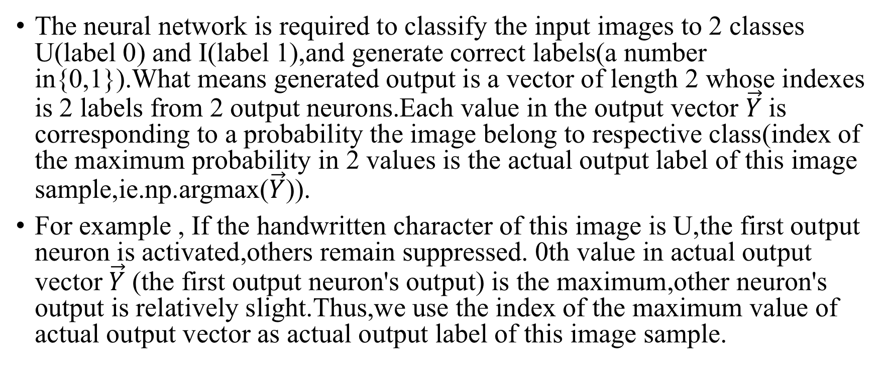
Classification Rule
The neural network is required to classify the input images to 2 classes U(label 0) and I(label 1),and generate correct labels(a number in{0,1}).What means generated output is a vector of length 2 whose indexes is 2 labels from 2 output neurons.Each value in the output vector $\vec{Y}$is corresponding to a probability the image belong to respective class(index of the maximum probability in 2 values is the actual output label of this image sample,ie.np.argmax($\vec{Y}$)).
For example , If the handwritten character of this image is U,the first output neuron is activated,others remain suppressed. 0th value in actual output vector$\vec{Y}$ (the first output neuron's output) is the maximum,other neuron's output is relatively slight.Thus,we use the index of the maximum value of actual output vector as actual output label of this image sample.

Slide 37
Neural Network Architecture
Input
Hidden layer
Output
x₁
y₇
1
_{0.5}
5
_{0.4}
8
_{0.3}
_{0.8}
_{0.7}
x₂
_{0.7}
2
_{0.2}
2
6
_{0.3}
x₃
_{0.6}
3
_{0.6}
_{0.1}
_{0.3}
_{0.2}
_{0.2}
_{0.4}
_{0.1}
x₄
y₉
4
_{0.3}
7
_{0.3}
9
Sigmoid

Slide 38
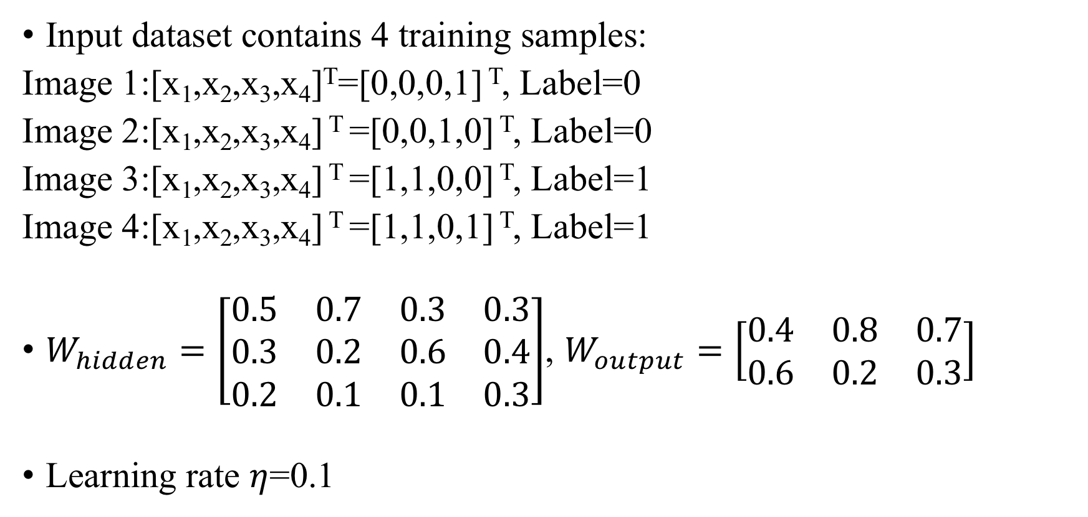
Initialization
Input dataset contains 4 training samples:
Image 1:[x₁,x₂,x₃,x₄]^{T}=[0,0,0,1] ^{T}, Label=0
Image 2:[x₁,x₂,x₃,x₄] ^{T} =[0,0,1,0] ^{T}, Label=0
Image 3:[x₁,x₂,x₃,x₄] ^{T} =[1,1,0,0] ^{T}, Label=1
Image 4:[x₁,x₂,x₃,x₄] ^{T} =[1,1,0,1] ^{T}, Label=1
$W_{hidden}=\left[\begin{matrix}0.5 & 0.7 & 0.3 & 0.3 \\ 0.3 & 0.2 & 0.6 & 0.4 \\ 0.2 & 0.1 & 0.1 & 0.3\end{matrix}\right]$, $W_{output}=\left[\begin{matrix}0.4 & 0.8 & 0.7 \\ 0.6 & 0.2 & 0.3\end{matrix}\right]$
Learning rate $η$=0.1

